Slide 1


Predictive Maintenance

Slide 2



Failure Detection through Anomaly Detection in
Time Series Data
The importance of Predictive maintenance
eXplainable Predictive Maintenance (XPM) project and
Baku Metropolitan
My project
Notes:
2

Slide 3
Reactive | Preventive | Predictive
After breakdown | At predefined intervals | When required
After breakdown | At predefined intervals | When required
Simple to implement, requires minimal planning and scheduling | Helps extend equipment lifespan by regularly servicing and replacing components | Reduces maintenance costs, minimizes downtime, enables proactive maintenance based on real-time data
Higher risk of unexpected downtime | May lead to over-maintenance or replacing parts prematurely, increasing overall expenses, some failures may still occur | Requires advanced monitoring technologies and data analytics capabilities

Slide 4

Baku Metropolitan
and eXplainable Predictive Maintenance (XPM) project in Porto, Portugalia
Notes:
3

Slide 5
About Dataset
The data span between 2022-04-28 and 2022-07-28
The Air Production Unit (APU) installed on the roof of Metro vehicles
8 analog sensor signals (pressure, temperature, current consumption), 8 digital signals (control signals, discrete signals), and 4 more columns about GPS information (latitude, longitude, and speed)

Slide 6
My Workflow
Data Preprocessing
Model selection
Feature Engineering
Exploratory
data analysis
Model evaluation

Slide 7
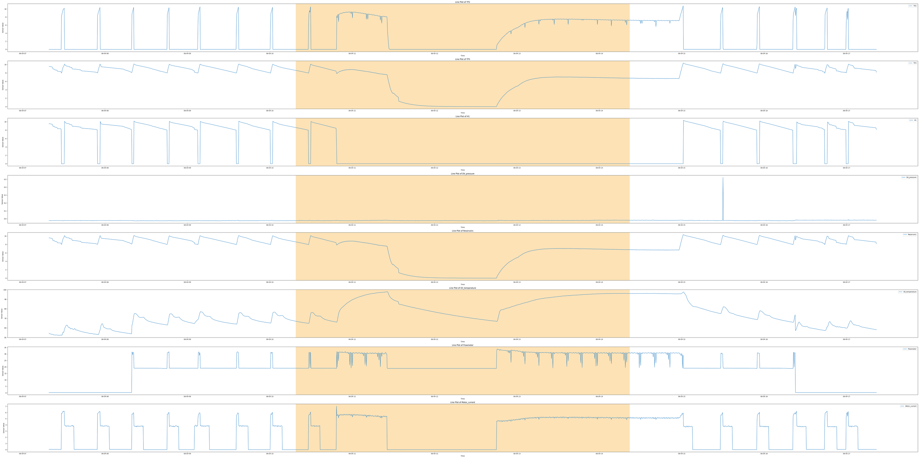
EDA - During Air Leakage

Slide 8
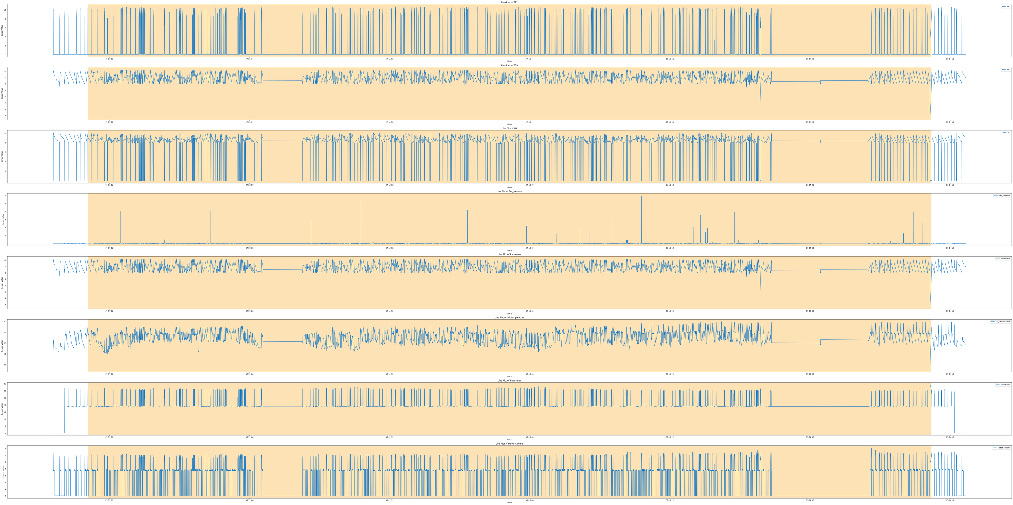
EDA - During Oil Leakage

Slide 9
Feature Engineering
Time-related features - seasonal patterns, trends, and cyclic behavior
Lag features - the relationship between a current observation and past observations
Detrend features -transform non-stationary time series data into stationary data.
Rolling features - smooth out noise and highlight underlying trends or patterns
CUSUM features - change detection

Slide 10
 | Accuracy | Precision | Recall | F1 score
Isolation Forest | 91 | 27 | 100 | 42
Histogram-Based Outlier Score | 93 | 31 | 97 | 48
Gaussian Mixture Models | 94 | 29 | 45 | 35
K-means clustering and the K-nearest neighbors | 96 | 49 | 75 | 59

Slide 11
Thank you

